Slide 1
WATER AID
PLEASE WE NEED YOUR HELP!

Slide 2
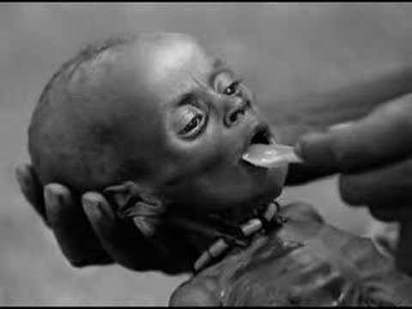

Slide 3
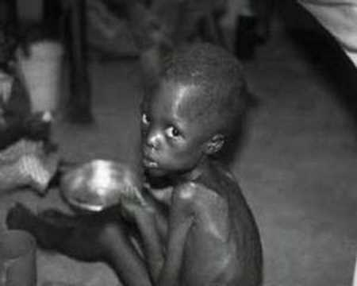

Slide 4
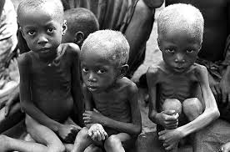

Slide 5
Just call 00311 5916 or text Water Aid to make a donation.

